Slide 1

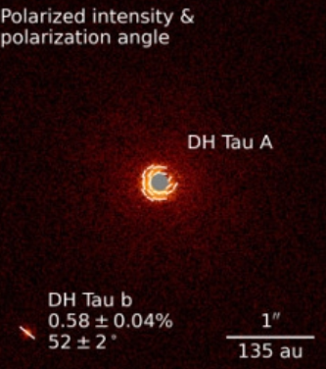
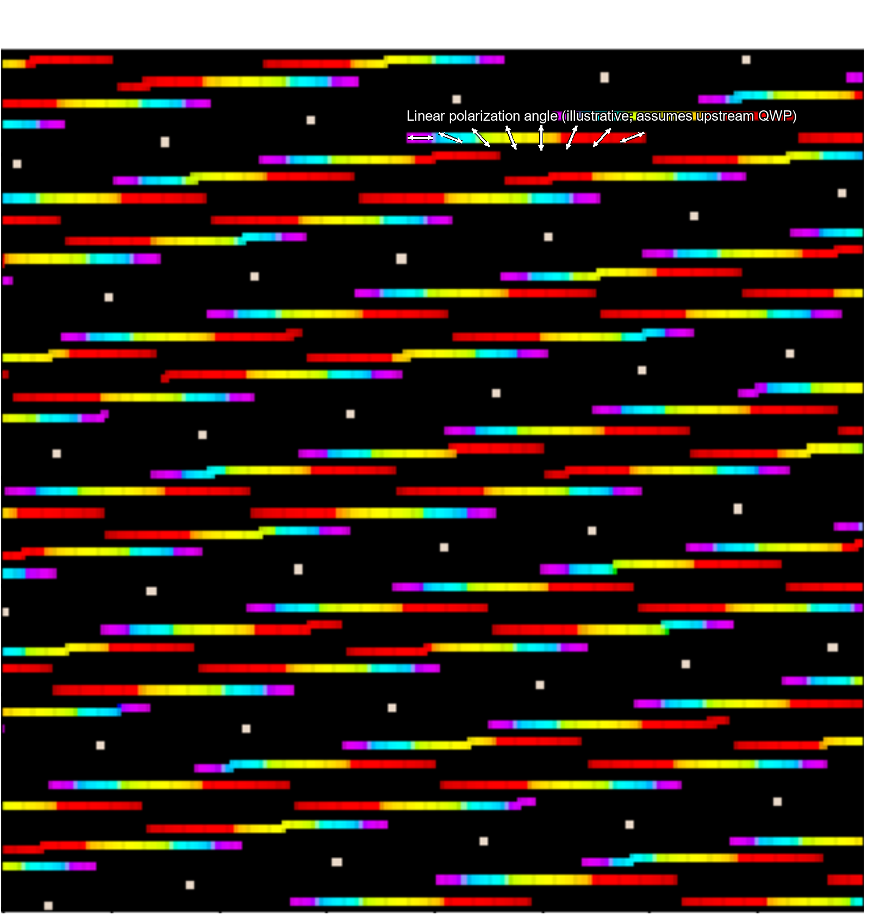

Lessons Learnt from Existing Instruments and R&D Programs for the Implementation of the Polarimetric Mode of the ELT’s High-Contrast Imager PCS
Daniel. Smith¹ • Sebastiaan. Y. Haffert¹ • Siddharth Maharana² • Matthias Tecza² • Miles Lucas³ • Maud Langlois⁴ • Rob van Holstein⁵ • Frans Snik¹
¹Leiden Observatory, Leiden University ²Dept of Physics, University of Oxford ³Steward Observatory, University of Arizona ⁴CRAL, Univ. Lyon ⁵ European Southern Observatory
1. Science Cases
● PDI boosts contrast by orders of magnitude for polarised circumstellar objects via polarised flux (Q,U); (spectro)polarimetry adds total intensity I which allows for fractional polarization (Q/I, U/I) for unambiguous scattering-microphysics diagnostics
● Both successfully image circumstellar disk structure (planet-forming & debris) and dust properties
● First sub-stellar companion polarisation detections: symmetry breaking in young gas giants' thermal (NIR) emission, e.g. via a moon-forming disk
● PCS extends this to disks/planets closer to the star, and to more distant objects
● First direct polarisation detections of mature planets in reflected light, possibly down to rocky M-dwarf planets, diagnostic of Rayleigh-scattering atmospheres, liquid water, even biopigments
● Qᵩ, Uᵩ polar coordinates: Qᵩ contains all single/symmetric scattering signal (immediate detection confirmation); Uᵩ for error analysis, sometimes hints at real disk physics
ESO/VLT/SPHERE/Van Holstein et al.
2. General Architecture
4. Polarisation Aberrations
● Polarisation properties differ fundamentally from WFE properties therefore design the full polarimetric system
● Modulator needed as far upstream as possible; can't sit at ELT's intermediate focus (after M1,2) therefore must investigate placement before M6 (fixed coordinate system vs. rotating M4,5)
● Modulator must switch Q,U states as fast as possible (vs. evolving speckles, in sync with detector read-out). Rotating achromatic HWP or active LC device; upstream components do not seem to hurt AO performance
● Dual-beam (simultaneous, identically-sampled images via a polarisation beam-splitter) mitigates most systematic effects
● Beam-splitter(s) can sit near the end of the train if the split states are “eigenvectors” of the train in between i.e. aligned with mirror s/p directions
● K-mirror can be a major issue: converts linear → undetectable circular polarization, up to 100% at ±45°; mitigate with extra HWPs, coating design, or observing strategy
3. Instrumental Polarisation Effects
● Polarisation-dependent phase/amplitude structure across the pupil creates polarisation structure in the PSF, beyond the average IP effect
● Fold mirrors → tip/tilt → beam shifts, splitting the PSF (possibly more than once) hurts both polarimetric and small-IWA coronagraphic performance
● Powered mirrors leads to polarisation astigmatism: non-zero Qφ in the Airy rings (can mimic/hide a disk signal) + randomly polarised speckles. Much more pronounced for ELT's F/0.9. Coronagraphic impact ~10⁻⁵; polarimetric impact significant. Segment-error impact likely minimal
● Open question: compensate with a metasurface optic, or remove reliably via “boring star” observations?
● M4,5 induces linear IP (in s/p directions) and ±45° linear to circular crosstalk. It is static in the co-rotating frame, varying only slowly with coating ageing
● If the modulator sits behind M6, ALL IP effects become variable all the time
● Calibrate regularly on-sky (standard stars, symmetric disks) which feeds a Mueller-matrix model in the reduction pipeline
5. Integral-Field Spectropolarimetry
● A LC polarisation grating enables a spectropolarimetric IFU: combines IFS with dual-beam polarimetry, sampled identically by the microlens array from the start
● Near-100% diffraction efficiency over an octave, splitting circular states in ±1 orders; + a static QWP is one standard mode always doing imaging SDI/spectroscopy AND PDI/polarimetry together
Daniel Smith | Polarimetry Lead, ELT-PCS | dsmith@strw.leidenuniv.nl | SPIE Astronomical Telescopes + Instrumentation 2026

